Slide 1

DECISION SUPPORT SYSTEM FOR A FINANCIAL INSTITUTION
BY
JAY BHANUSHALI
ROHIT TAPARIA
VENKAT AKHIL KORTHIWADA
VIREN BHANUSHALI

Slide 2

EXECUTIVE SUMMARY
The Decision support system at VVRJ Bank is concerned with managing the finances, the investment data of every investor and the data related to the loans of each borrower.
The principal motive of the DSS is to make timely and precise decisions, to properly segregate the data and easy to read the investor data for each financial investment.
The focus of this project is to develop a DSS which is capable of doing the following:
Add, Update or Delete the data of a specific investor or borrower.
Maintaining data about every investor’s investment in either of the three financial instruments: Fixed Deposits, Debentures and Shares.
Maintaining data about every borrower and amount borrowed.
Managing Financial Reports.
Studying the Trend of Investments over the years through statistics, graphs and making the precise decision accordingly.

Slide 3
END USERS
Employees
Investors
Borrowers
Database Administrator

Slide 4
DESIGN CONSIDERATON
There are only three types of Financial Instruments available through which you can invest: Fixed Deposits, Debentures and Shares.
There are only three types investors: Individuals, Institutions and Employees.
The rate of interest for each is fixed and not variable.
An investor invests in atleast one of the Financial Instruments.
The data used is a dummy data.
Close to Maturity is taken to be a time span of 90 days.
An investor can invest only in one financial instrument at a time.
Fixed Deposits have investments that have fixed duration (i.e. 1, 2, or 3 years) with only two schemes: scheme 1 and scheme2

Slide 5
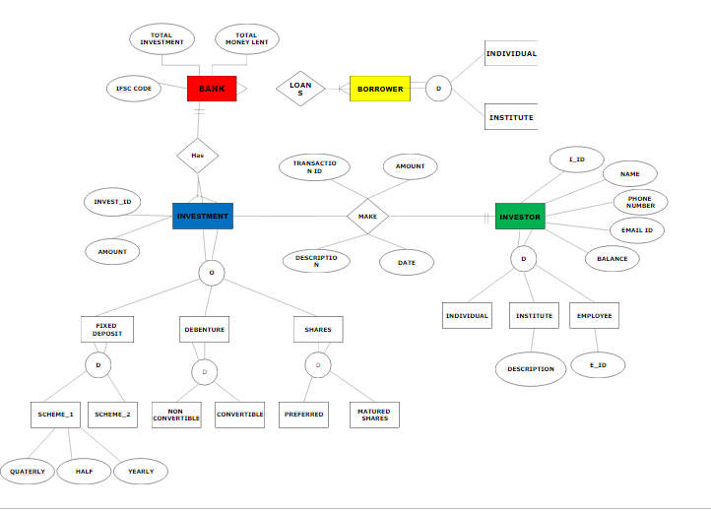
Entity Relationship Diagram

Slide 6
GUI & FUNCTIONALITY
Sign In / Sign Up Page
Multiple User Form:
Database
Update
Financial Instruments
Investors
Manage Accounts
Summary
Financial Reports
Statistics, Graphs & Data Analysis

Slide 7
LIVE DEMONSTRATION

Slide 8
CONCLUSION
Speedy Computation and Problem Solving
Improved Quality of Decision Making
Increased Organizational Control
Management of Investors’ and Borrowers’ data
Add, Update and Delete data
Management of Financial Reports
Depict the trend of Amount Invested in different Financial Instruments over the years using graphs and statistics
Depict the amount borrowed by different borrowers over the years through graphs and statistics
Easy Access to particular data for the employee and database administrator
Ability to feed lessons learnt back into the decision-making process

Slide 9
LESSONS LEARNT
Functionality of MySQL and Workbench
Importance and Diversity of Excel
Application and Vastness of Visual Basic Application
Significance and Appeal of Graphic User Interface
Passage of values from one user from to another
Usage of ADODB and application of connection of EXCEL, VBA to Workbench.
Importance and Usage of Macros
Interacting Graphs on Excel through database

Slide 10
THANK YOU !!!

Slide 11

QUESTIONS

